Slide 1
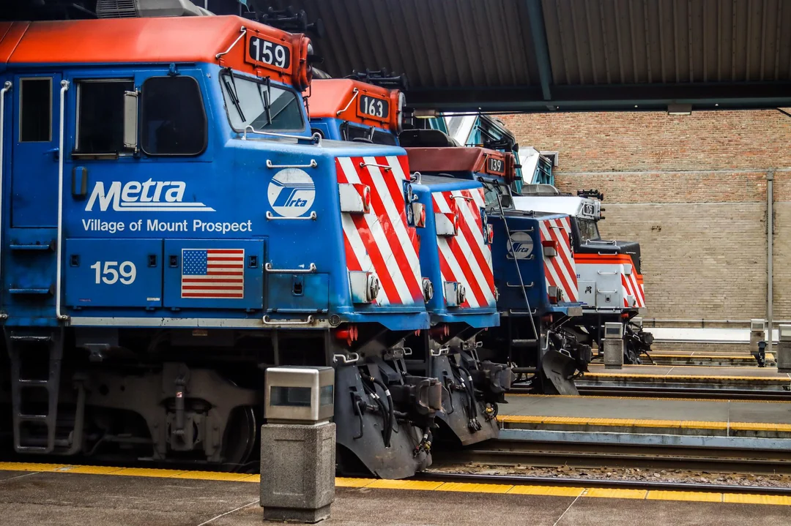
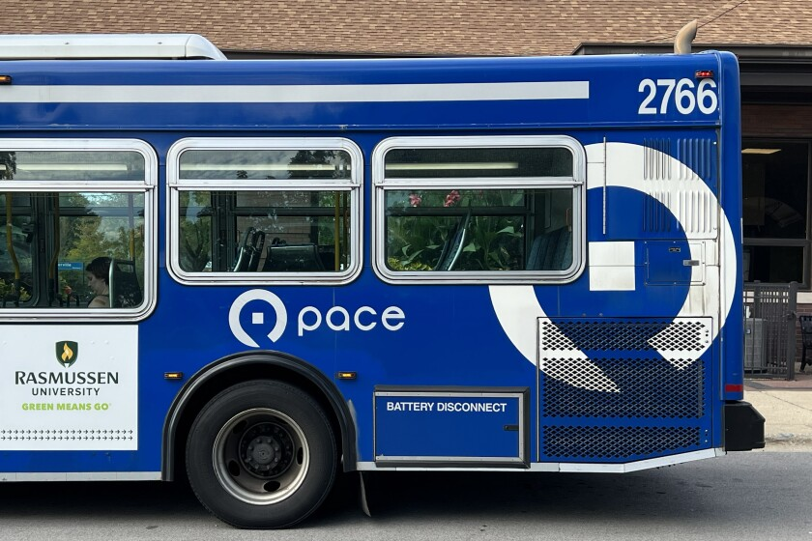

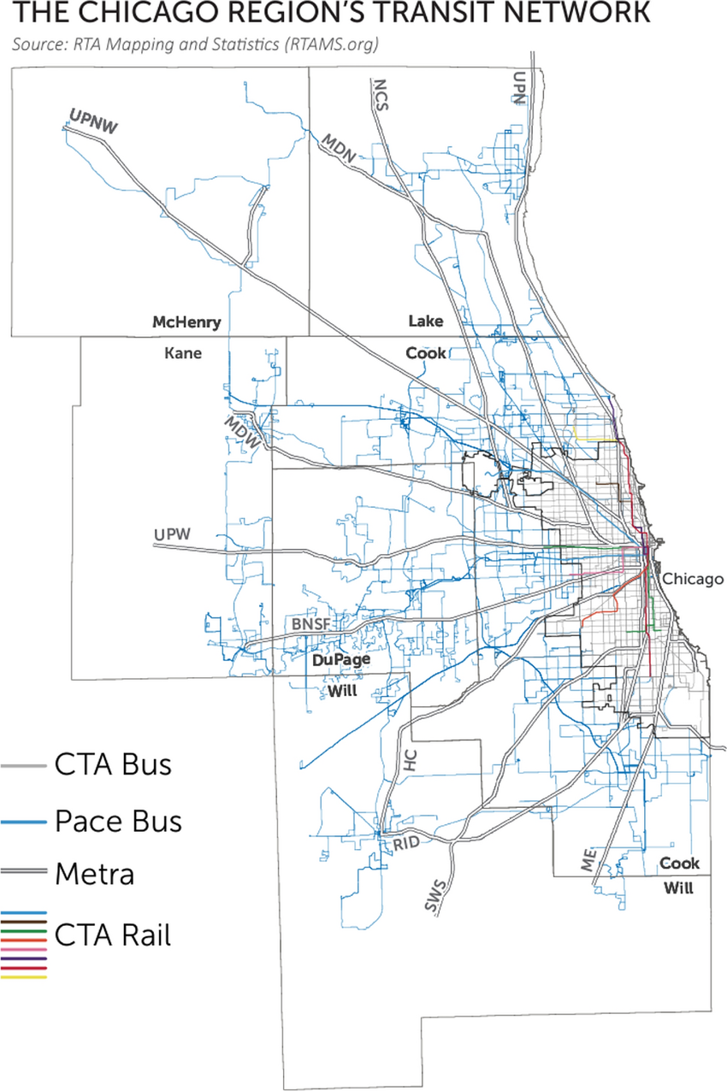

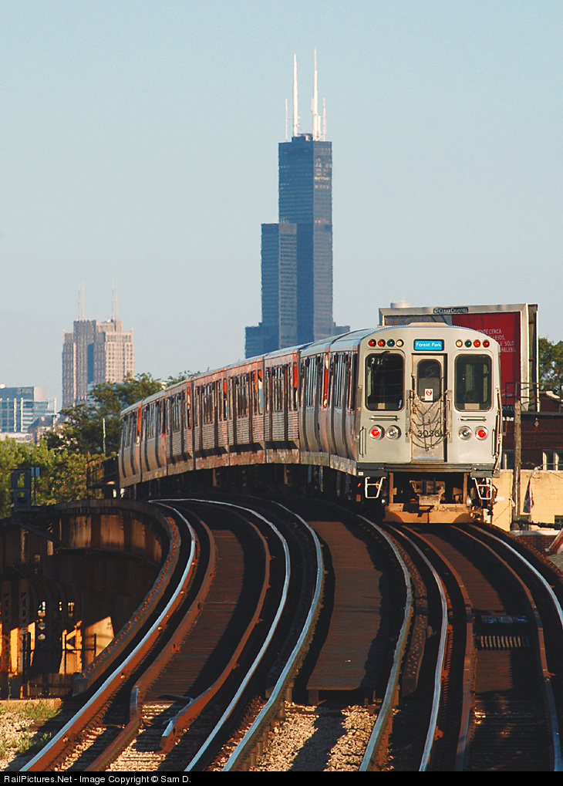



NITA: Transforming Transit for Our Communities
An Overview of NITA and Its Impacts

Slide 2

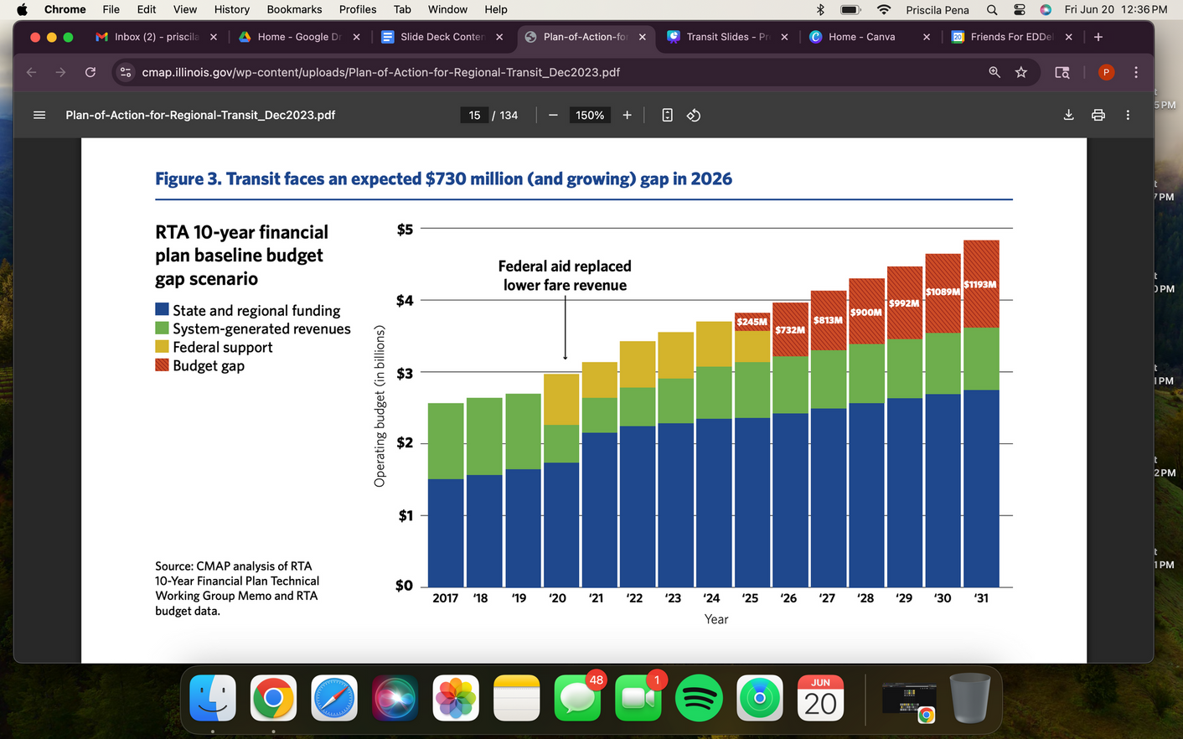
Why Transit Reform Can’t Wait
    Fragmented systems = inconsistent service
    Outdated funding structures & limited coordination
    Riders frustrated by transfers, delays, and confusion
    10-year trend: declining ridership, increasing cost per trip

Slide 3
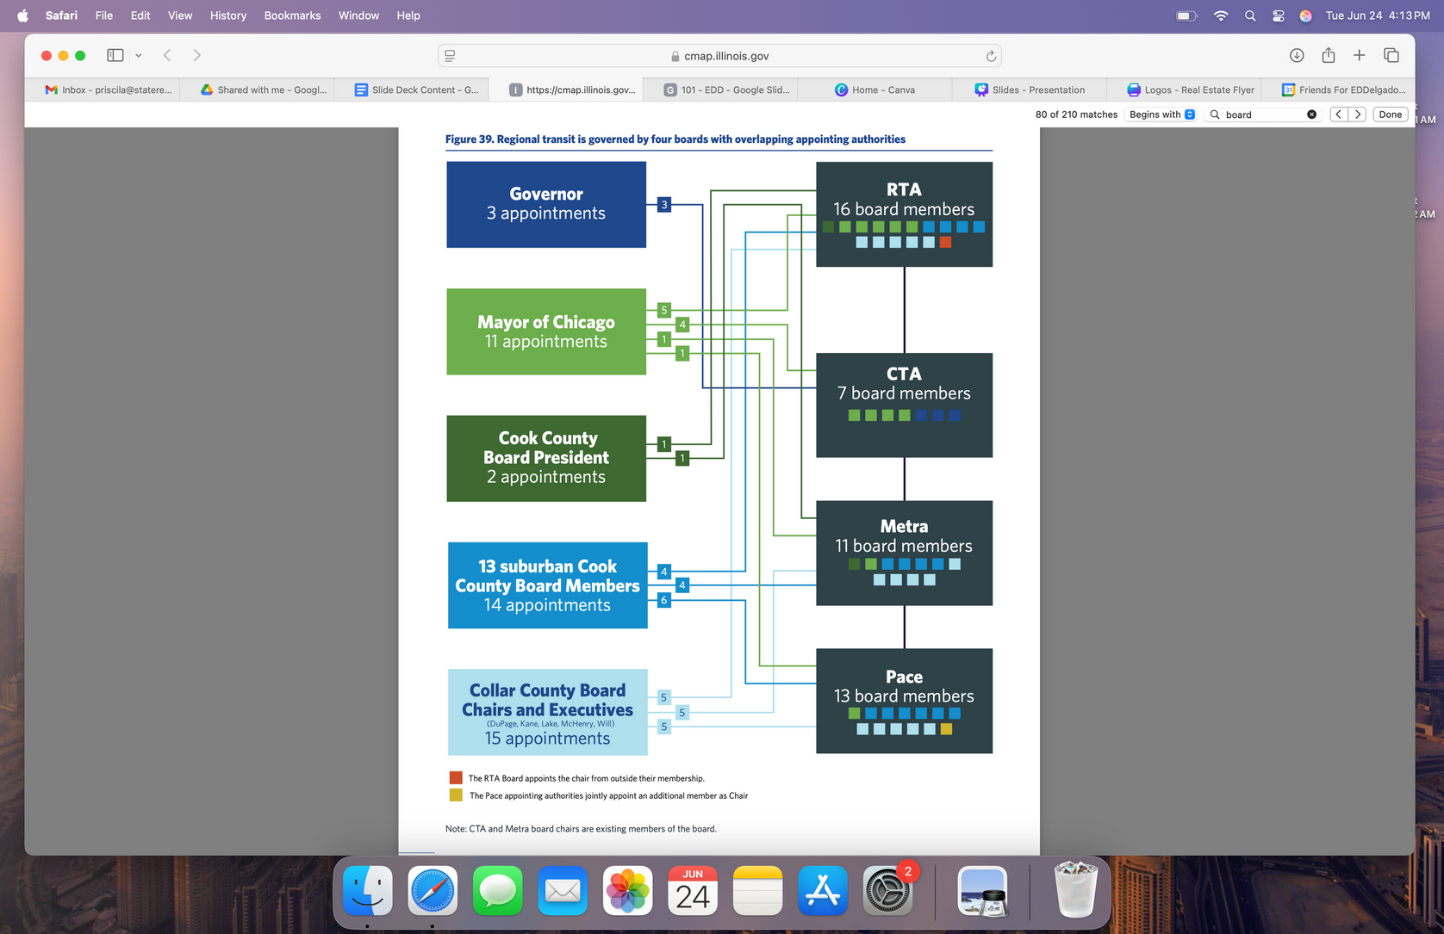


Governance: Current Board Structure
Note: No board members hold dual appointments

Slide 4










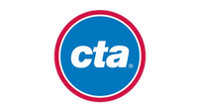

















Governance Reform: NITA Board
NITA Board: 20 members
Governor:
5 Appointments
Chicago:
5 Appointments
Cook County:
5 Appointments
Collar Counties:
5 Appointments
1
2
3
4
5
1
2
3
4
5
1
2
3
4
5
1
2
3
4
5
7 Board Members
11 Board Members
11 Board Members
1
2
1
2
3
1
2
1
1
2
1
2
3
1
2
3
4
5
1
1
2
1
2
3
1
2
3
4
5
Note: White cells indicate an external board member
+
=
20
12
32
Total
Board
Members
NITA
External

Slide 5






Current Transit Structure
RTA
Responsibilities
Approves Budget
Fare policy
Fare policy
Fare policy
Capital funding
Capital funding
Capital funding
Sets service schedule
Sets service schedule
Sets service schedule
Service planning
Service planning
Service planning
Strategic planning
Strategic planning
Strategic planning
Communications & Lobbying
Communications & Lobbying
Communications & Lobbying

Slide 6
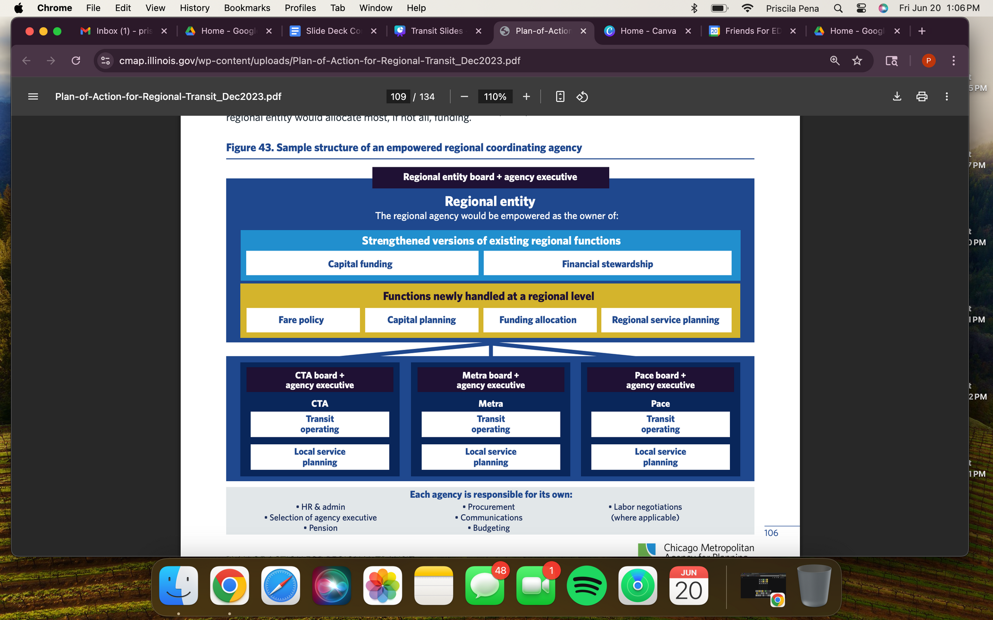





NITA will oversee CTA, PACE and Metra as Operators
NITA
Responsibilities
Newly Assigned Regional Functions

Slide 7



Additional Public Oversight: Advisory Councils
Riders' Advisory Council
The ADA Advisory Council
Regional Service Council
Provides direct input from transit users on:
    Service quality
    Fare equity
    Rider experience
    ensuring diverse regional and demographic representation.
Advises NITA on:
    Accessibility policies
    Paratransit services
    Infrastructure improvements for riders with disabilities
Offer localized guidance on service planning and operations, reflecting the unique needs of specific geographic areas within the NITA region.

Slide 8



Transit Safety Task Force: Immediate Response to Safety
    Rapid-response task force to tackle immediate safety needs across bus and rail systems in the region
    Deploy frontline safety and social service resources: increased ambassadors, trained security, and coordinated law enforcement presence
    Use data-driven insights to target high-risk routes and times
    Builds trust by requiring public reporting and input from community advisory councils
Why this Matters
    Immediate improvements in safety across the region.
    Shared responsibility: safety becomes a partnership, not just enforcement.
    Coordination across the region allows for effective responsiveness to crime and criminal activity

Slide 9


Transit Ambassadors: Long-term Response to Safety
    NITA authorizes use of transit ambassadors
    These ambassadors can help de-escalate situations, offer directions, and connect people to services.
    Cities like Philadelphia, New York, and Los Angeles have adopted similar programs with measurable success.
Why this Matters
    Transit riders are calling for safety without aggressive policing
    Trained ambassadors reduce confrontations and build a more welcoming, rider-friendly system.
    The program partners with social service organizations to connect individuals to housing, mental health care, and support services.

Slide 10






Oversight: Office of the Executive Inspector General
    NITA expands oversight to include all major transit agencies and their leadership, including CTA, Metra, Pace, and NITA.
    NITA gives investigators the power to root out fraud, waste, abuse, and misconduct across the entire transit system.
    NITA requires monthly public reports and shared accountability to ensure transparent, proactive oversight.
Strengthens ethical standards across all transit agencies
Detects and prevents misuse of public funds
Increases public trust through independent oversight
Enables whistleblower protections and accountability

Slide 11








NITA: Better Service, Simpler System
One fare system, one app, unified timetables
Faster, data driven service improvements
Reduced administrative overhead=more $$ to service
Accountability through performance audits and transparency mandates

Slide 12





Transit Oriented Development
    The NITA proposal removes mandatory parking requirements near transit
    TOD = building housing, retail, and jobs near frequent transit corridors and hubs
    Encourages compact, walkable neighborhoods while cutting car dependency
    Local zoning will not be impacted
Regional Impact
    TOD encourages more housing near jobs and transit, reducing congestion and emissions
    Chicagoland's current TOD potential is underutilized due to zoning and parking mandates
Increases sales and lowers property taxes near stations
Cuts infrastructure costs for municipalities
Enables revenue growth through increased ridership

Slide 13

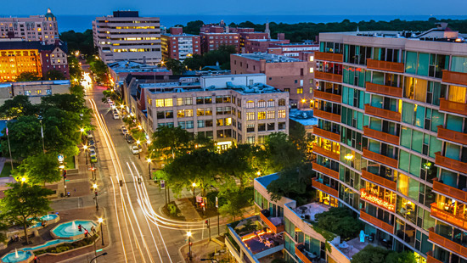
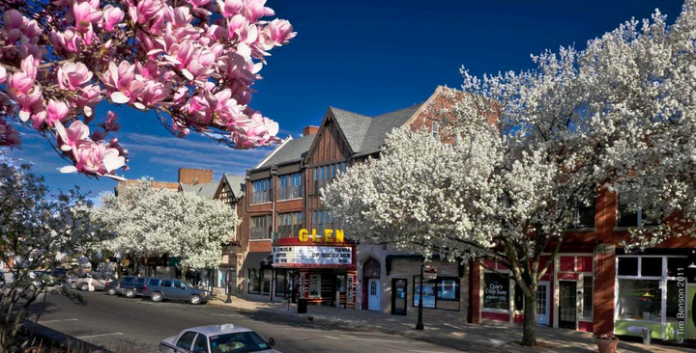
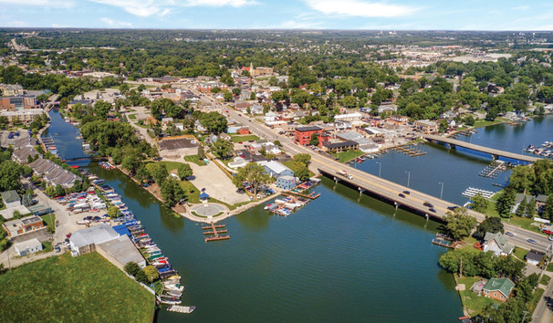


True Regional System
    One fare system, one timetable and real-time arrival data
    Priority investments in high-ridership corridors
    Planning based on data like ridership trends, population density, and job hubs
    Regional coordination to address service gaps
    Expansion of “regional connector” routes
    Investments in stations that serve as transfer hubs between agencies
    Last-mile service pilots
    Reverse commute pilots supporting suburban employment centers

Slide 14








What NITA Means for the Suburbs and Collar Counties
Fair Voice in Governance
Better Suburban Service
More Value from Existing Dollars
    Under NITA, collar counties retain equal board appointments.
    Regional input councils ensure local voices guide service planning.
    Expands reverse-commute and “last-mile” pilots for job centers (e.g., O’Hare, Oak Brook, Northbrook).
    Unified app + real-time arrival data = easier transfers between Metra, Pace, CTA.
    Less duplication between agencies means more funding goes to service—not bureaucracy.
    Suburbs benefit from capital investments planned based on need, not politics.

Slide 15




What’s at Stake for Suburbs
Gridlock. Missed shifts. Stranded workers.
Losing Service = Losing Jobs
More Traffic, Higher Costs
Suburban Businesses Suffer
    Congestion on I‑290, I‑94, I-90, I-55, and other corridors worsens for everyone, not just transit riders
    Travel time up 14–35% - that means a one hour drive turns into 90 minute drive
    Each 5% drop in transit ridership adds tens of thousands more cars to the road
    Up to 100,000 daily suburban workers rely on Metra and Pace
    Without action, RTA projects a $730M budget shortfall by 2026, triggering service cuts.
    Employers in Schaumburg, Downers Grove, Oak Brook & others rely on transit commuters
    Cuts in bus routes and train frequency make these jobs harder to fill.

Slide 16

NITA: Built with Community Input
    Hosting regional town halls to explain the NITA proposal and gather public input
    Sharing local feedback with state legislators ahead of veto session deliberations
    Ongoing surveys, town halls, and public feedback
Town Halls
Surveys
Workgroup
Meetings
Subject Matter
Hearings
Veto Session

Slide 17




Call Your State Representative
Tell them: We need a simpler, unified transit system now.
Take the Survey
We deserve a transit system that works for everyone.

